Slide 1
GenAI Hackathon
Oracle Transportation Management Assistant
September 06, 2024
1
Copyright © 2024, Oracle and/or its affiliates

Slide 2



PROBLEM STATEMENT
Service Request
Response
Customer
OTM support team
Resolution speed depends on team availability, and workload.
Create an generative AI assistant which generates primary solutions to the incoming SR’s for support teams reference, based on the knowledge modules and product documentation.

Slide 3
USE CASE : OTM ASSISTANT
What is it?
The Challenge
SR resolution is time-consuming.
Similar SRs may already exist in the knowledge modules.
Solutions could be found in product documentations too.
Locating relevant documentation among all the product documentations is tedious and time consuming.
Impact of OTM Assistant
Accelerate the SR resolution.
Reduce the workload of OTM support team
Improved customer experience
Inputs
Query
‘Tools’ – pre-defined assets E.g., Product documents, Knowledge modules.
Notes:
The use case that we seek to present and demo today is the service request resolution agent where we utilize the power of LLM together with an innovative approach to problem solving.
Added to this, as you can see, there are a number of factors that tend to lower the speed and quality of service delivery. In addition to delayed responses, re-opening of issues is not uncommon, leading to further customer dissatisfaction.
How can Gen AI help? When a new issue is presented as a Service Request, the Resolution Agent auto generates a response, which could be the “next action” for the service rep to take, or a solution to the problem for the service rep to review and share with the customer. The agent uses pre-defined assets at its disposal in order to achieve this. These assets could be KM content such as articles/FAQ’s, manuals or previously solved similar SRs.
The typical inputs used to understand the issue are as listed on the slide – the SR content, Knowledge content and previously solved similar SRs.
Let us see this in a action via the Demo…..
When a customer raises a support ticket, an SR* is created and routed to a service rep for review and solution suggestion. The speed and quality of the solution depend on the rep's availability, workload, skill level, experience, and the issue's complexity.
Multiple interactions and involvement of several reps may be needed, often causing delays, issues-reopening, customer dissatisfaction, and potential churn.
Service Request

Slide 4
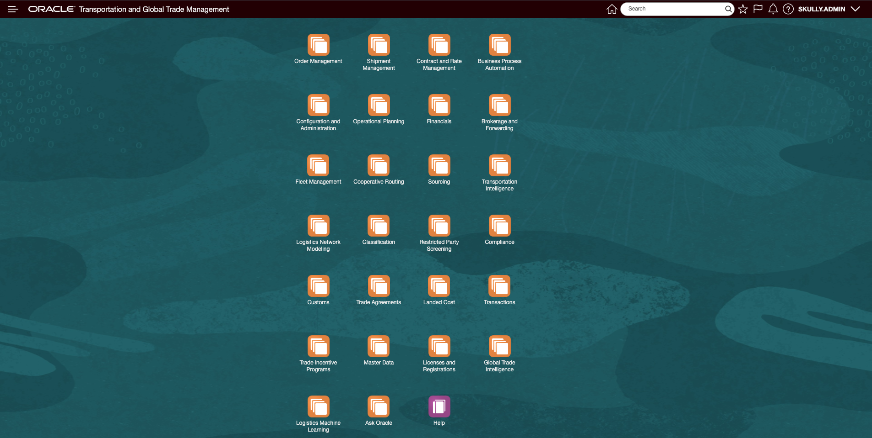


USE CASE : OTM ASSISTANT (Cont.)
OTM Assistant

Slide 5


AI AGENTS
SR Knowledge Agent
Summarizer Agent
Documentation Agent
Citations Agent

Slide 6
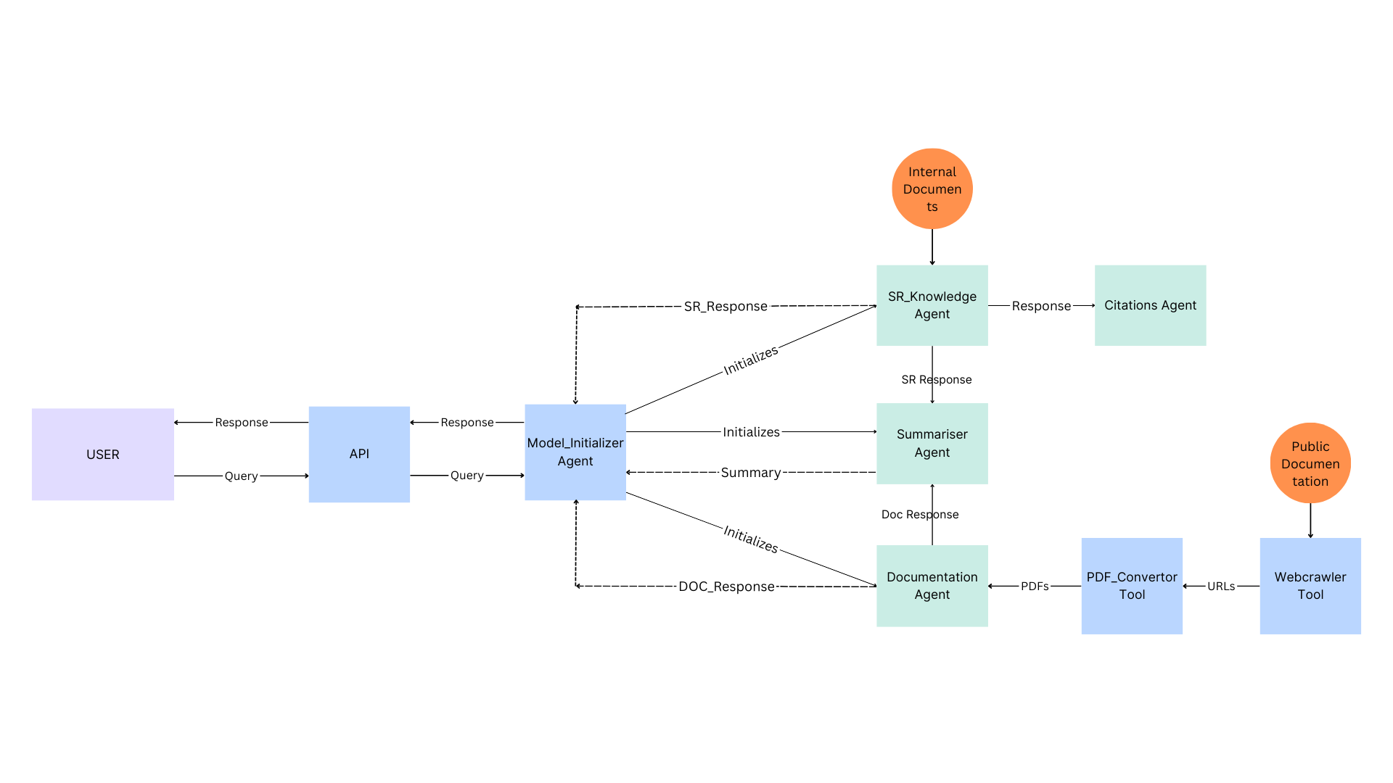
WORKFLOW

Slide 7
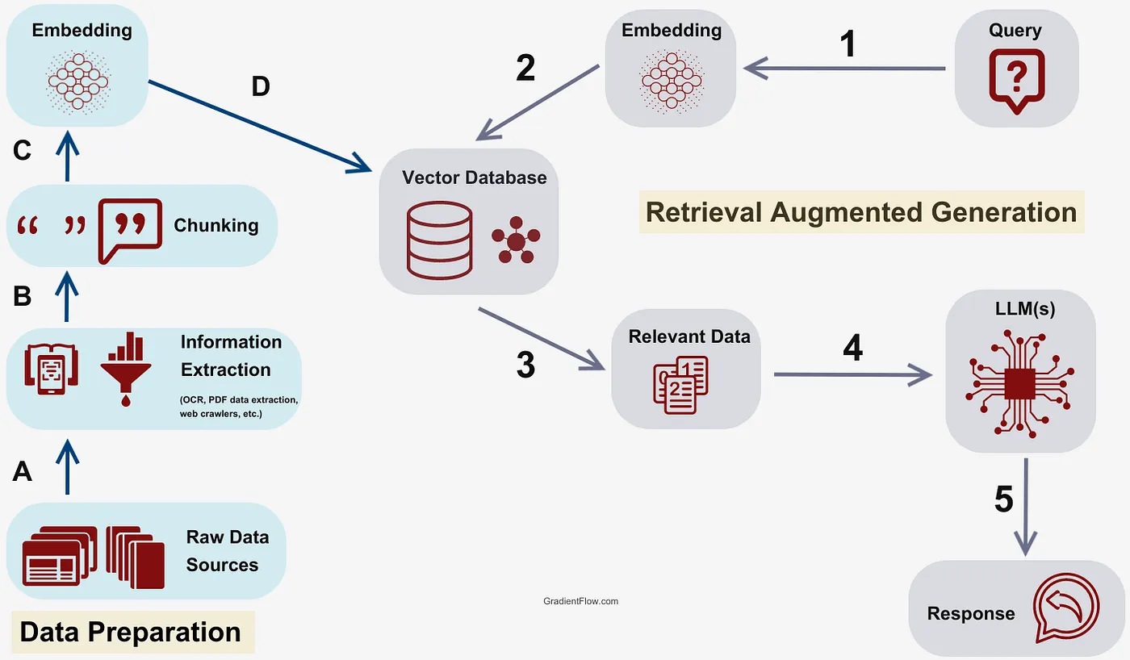
How does RAG work?

Slide 8

MODELS
Mixtral-8x7b-32768 LLM Model
Groq
Embedding Model
FastEmbed Embedding
“BAAI/bge-base-en-v1.5”
Summarizing Model
“t5-small” summarizing model from Hugging Face
8
Copyright © 2024, Oracle and/or its affiliates
Notes:
AI Agent is a piece of software program/ application that orchestrates and automates the tasks
It becomes more sophisticated by implementing ReAct model that combines reasoning and actions
Key aspects is to leverage LLM as a reasoning engine that determines which action to take in which order.

Slide 9
DEMO

Slide 10

TOOLS/ TECHNOLOGIES USED
TECHNOLOGIES
TOOLS
Python
Postman
Fastapi
Langraph
Llama
Qdrant
Groq
VBCS
WebCrawler
10
Copyright © 2024, Oracle and/or its affiliates
Notes:
AI Agent is a piece of software program/ application that orchestrates and automates the tasks
It becomes more sophisticated by implementing ReAct model that combines reasoning and actions
Key aspects is to leverage LLM as a reasoning engine that determines which action to take in which order.

Slide 11


OTM ASSISTANT FEATURES
Service Request
Chatbot
Public Documentation
Generate summary
Generate response from public documentation
Generate citations
Generate answers for SR
Chat Agent Assistance
Crawl Public Documentation

Slide 12
FUTURE ASPECTS
Make it more Scalable
Implement role-based access control
Auto-updating SR system
Store past queries for reference
Integrate a feedback loop for continuous improvement

Slide 13
TEAM CONTRIBUTION
Sathwik Posa
Arun Kaluvakolanu
Rohit Taparia
Sanika Tare
Himanshu Kumar
Model Building
Building Agents
Modifying one tool
Backend
Making one tool
Building agents
Created UI, using VBCS
Model integration with the frontend
Research
Model Building
UI Design
Agents Workflow
Research on RAG
Backend
13
Copyright © 2024, Oracle and/or its affiliates
Notes:
Our first few releases have focused on agent productivity and as you can see it covers all areas of service –
Agent facing service center,
Chats
Knowledge authoring
Generating troubleshooting interviews that can be incorporated in service workflows

Slide 14
Thank You…

